Slide 1
Algorithms & Data Structures
Text Mining Tries, KD-Trees & Workshop Week 1
Jacob Trier Frederiksen & Anders Kalhauge
Spring 2019

Slide 2
Program, Week 18
Test Exam & solution suggestion; hand-back
Overview: the last weeks of the course
Final Exam: information and clearing occasional questions
Project 5:
overview
choosing project
hand-out
Two last theortical bits:
Text Mining, ‘Tries’ (Ch. 5.2)
kD-Trees, (con amore -- but part of one project 5 choice)

Slide 3
Program, Week 18
Test Exam & solution suggestion; hand-back
Overview: the last weeks of the course
Final Exam: information and clearing occasional questions
Project 5:
overview
choosing project
hand-out
Two last theortical bits:
Text Mining, ‘Tries’ (Ch. 5.2)
kD-Trees, (con amore -- but part of one project 5 choice)

Slide 4
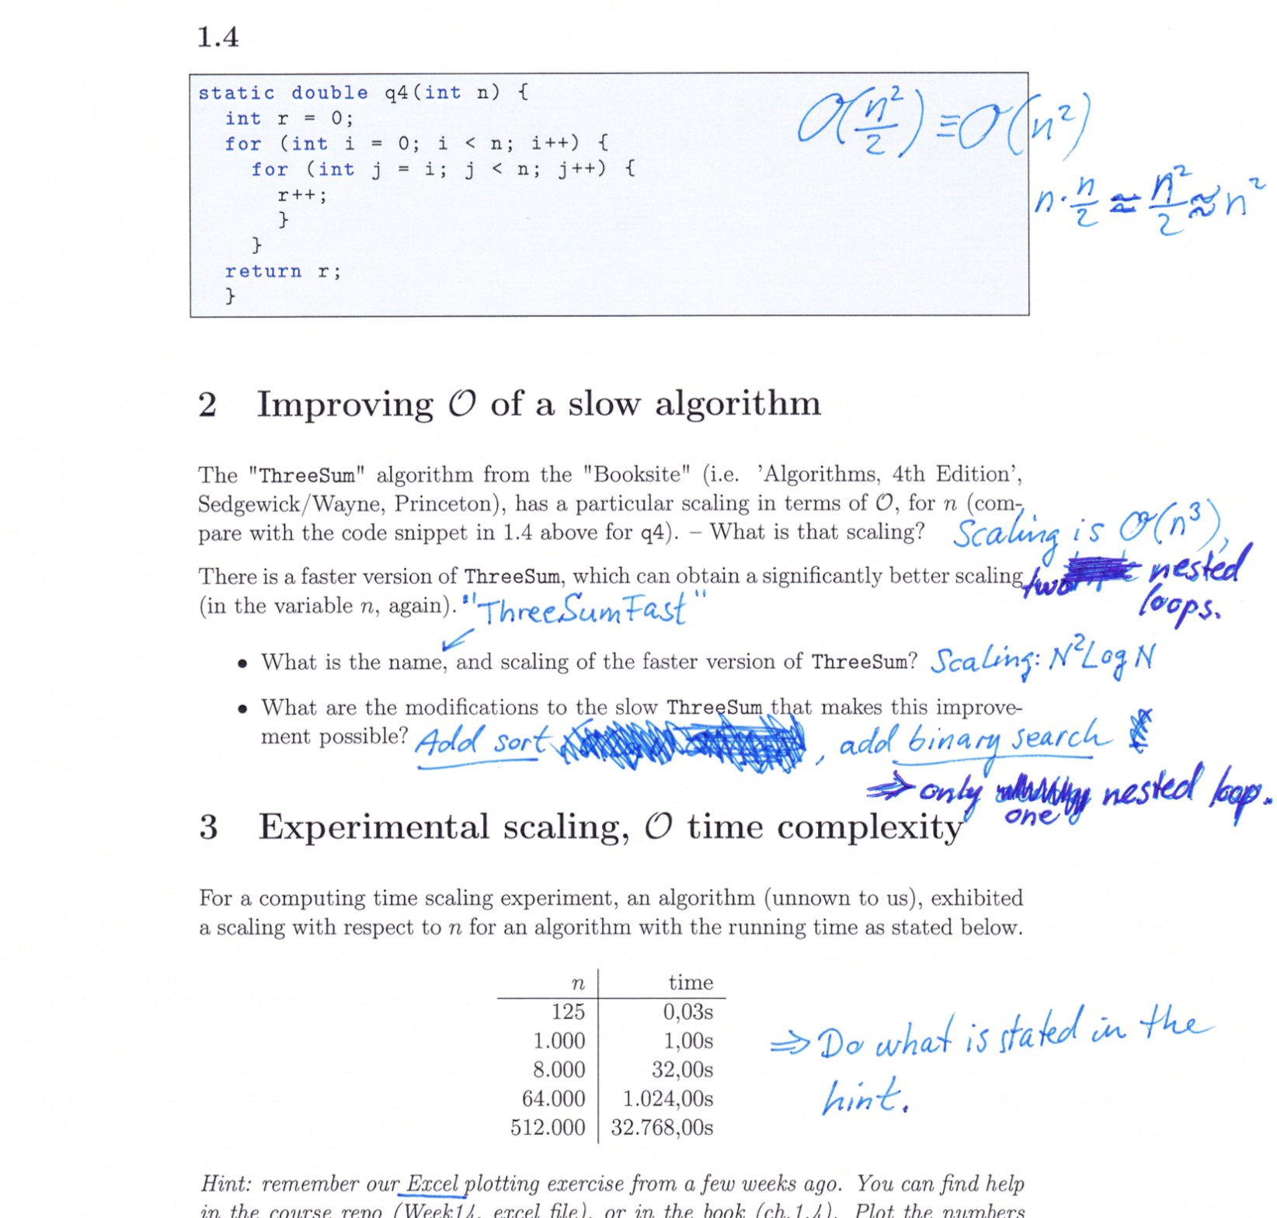
Test Exam & solution suggestion; hand-back
NB: This was an exercise, which we decided to do
NB: It is not graded
NB: Meant only as an indicator of your standing on knowledge
NB: There is still time before the finals

Slide 5
Program, Week 18
Test Exam & solution suggestion; hand-back
Overview: the last weeks of the course
Final Exam: information and clearing occasional questions
Project 5:
overview
choosing project
hand-out
Two last theortical bits:
Text Mining, ‘Tries’ (Ch. 5.2)
kD-Trees, (con amore -- but part of one project 5 choice)

Slide 6
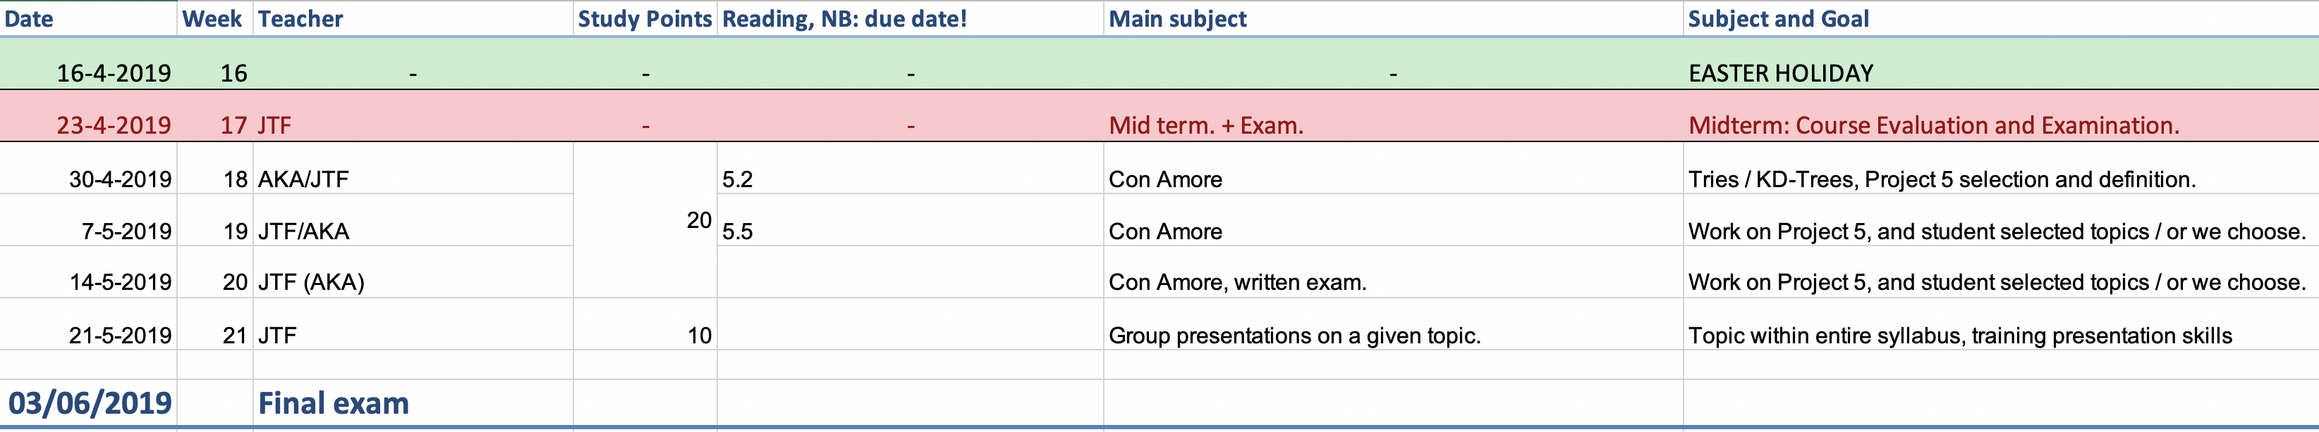
Overview: the last weeks of the course – ‘Looking for the summer...’ [Chris Rea]

Slide 7
Program, Week 18
Test Exam & solution suggestion; hand-back
Overview: the last weeks of the course
Final Exam: information and clearing occasional questions
Project 5:
overview
choosing project
hand-out
Two last theortical bits:
Text Mining, ‘Tries’ (Ch. 5.2)
kD-Trees, (con amore -- but part of one project 5 choice)

Slide 8
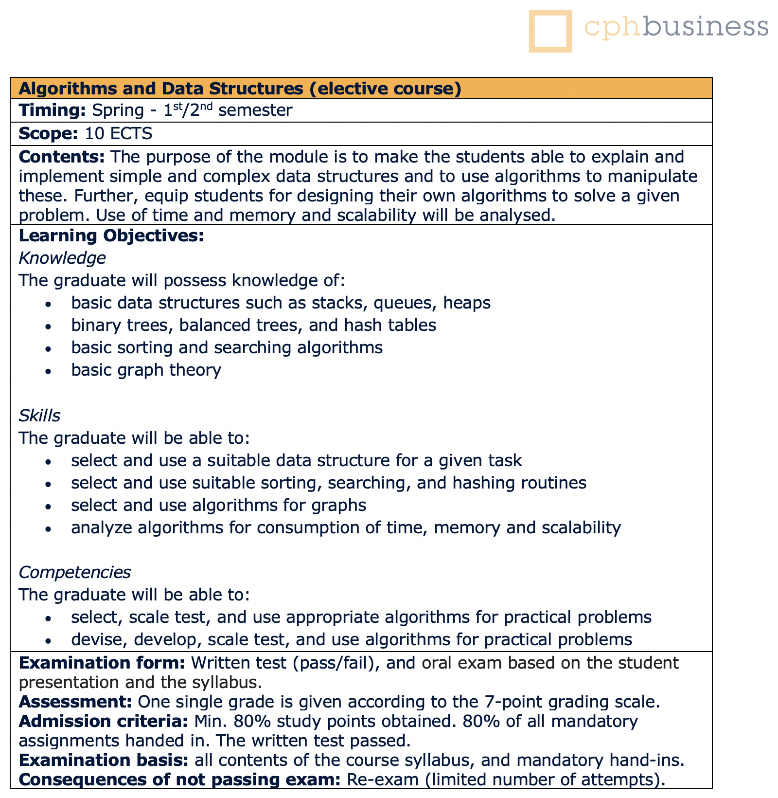
Final Exam: information
Information from the Course Catalogue

Slide 9
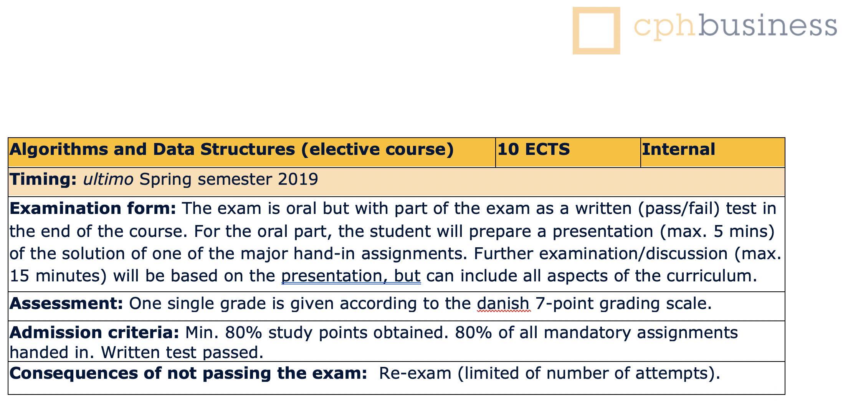
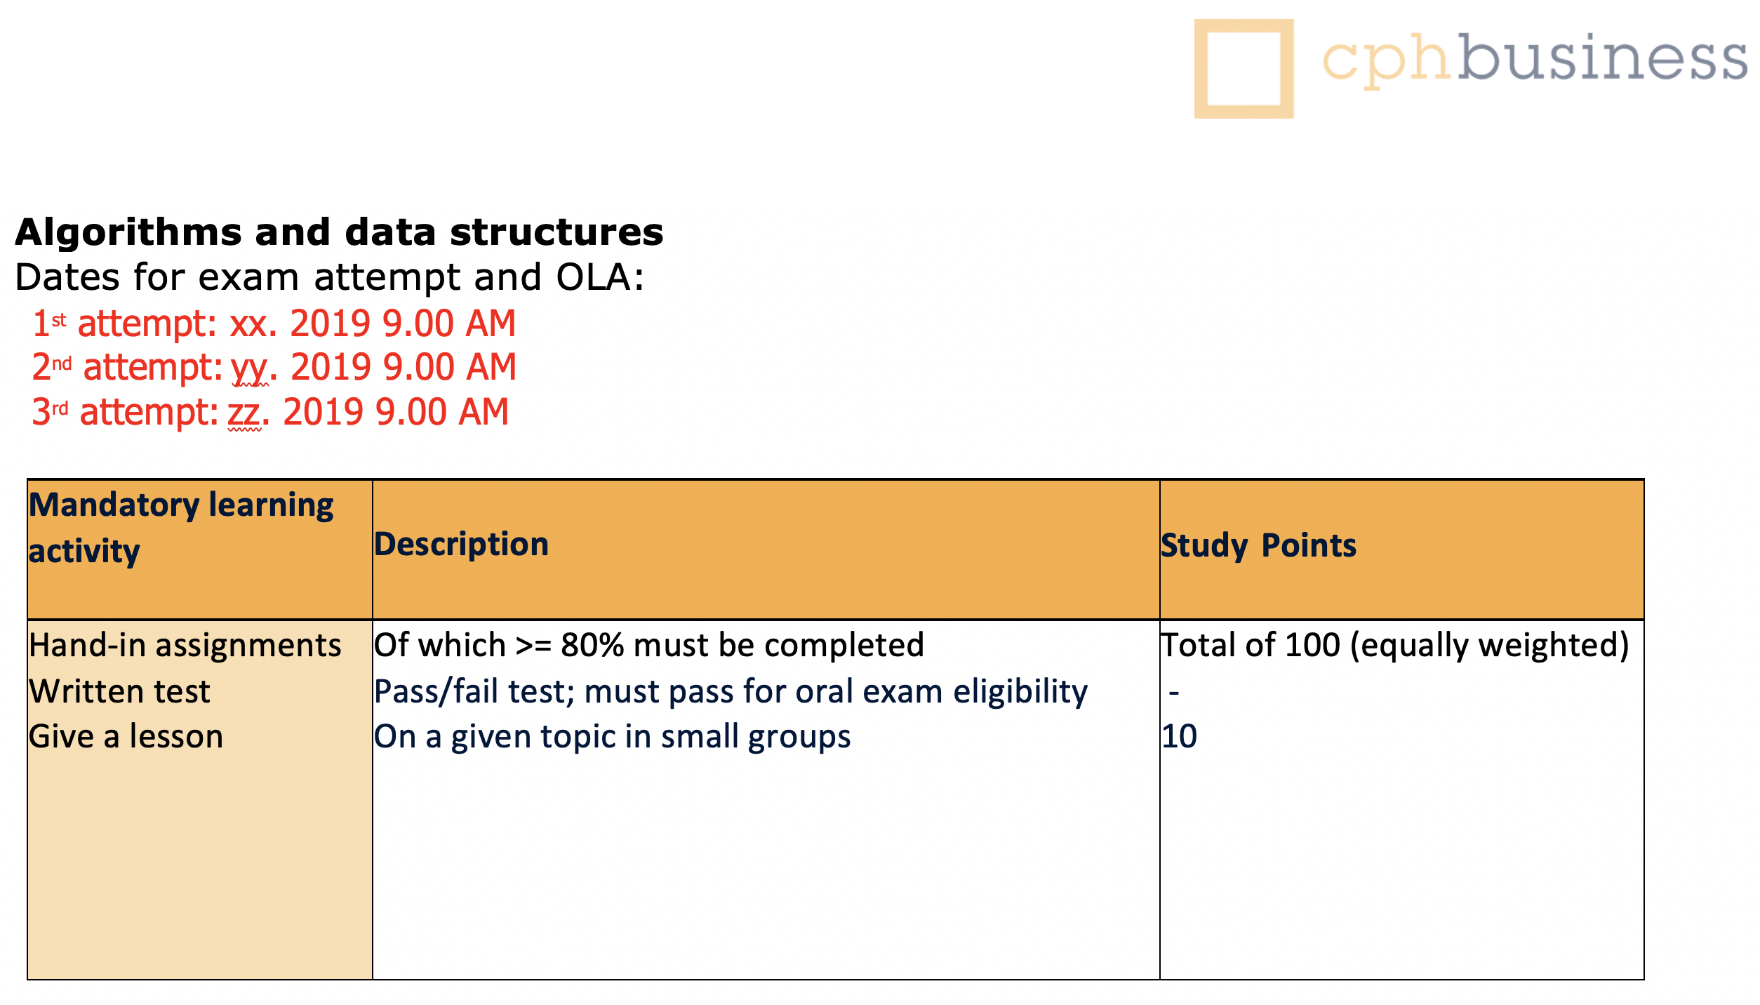
Final Exam: clearing occasional questions
Exam details
Study Points

Slide 10
Program, Week 18
Test Exam & solution suggestion; hand-back
Overview: the last weeks of the course
Final Exam: information and clearing occasional questions
Project 5:
overview
choosing project
hand-out
Two last theortical bits:
Text Mining, ‘Tries’ (Ch. 5.2)
kD-Trees, (con amore -- but part of one project 5 choice)

Slide 11
Project 5 – reaching a level of independence...
You get to choose your topic (from a list of four):
Out-of-core Sorting of ‘Big Data’ (by volume, not heterogenity)
Text Mining, Tries, sorting of ‘Big Data’ (by variety, and volume)
Error detection in sorting of ‘Big Data’ (by volume, not heterogenity)
kD-Tree acceleration, searching kD spaces w/applications

Slide 12
Program, Week 18
Test Exam & solution suggestion; hand-back
Overview: the last weeks of the course
Final Exam: information and clearing occasional questions
Project 5:
overview
choosing project
hand-out
Two last theortical bits:
Text Mining, ‘Tries’ (Ch. 5.2)
kD-Trees, (con amore -- but part of one project 5 choice)

Slide 13
Text Mining
‘Tries’ by Anders Kalhauge
Relevant in particular for project 5 on text mining
Relevant generally for exam and in real ”IT Life” ☺

Slide 14
Program, Week 18
Test Exam & solution suggestion; hand-back
Overview: the last weeks of the course
Final Exam: information and clearing occasional questions
Project 5:
overview
choosing project
hand-out
Two last theortical bits:
Text Mining, ‘Tries’ (Ch. 5.2)
kD-Trees, (con amore -- but part of one project 5 choice)

Slide 15
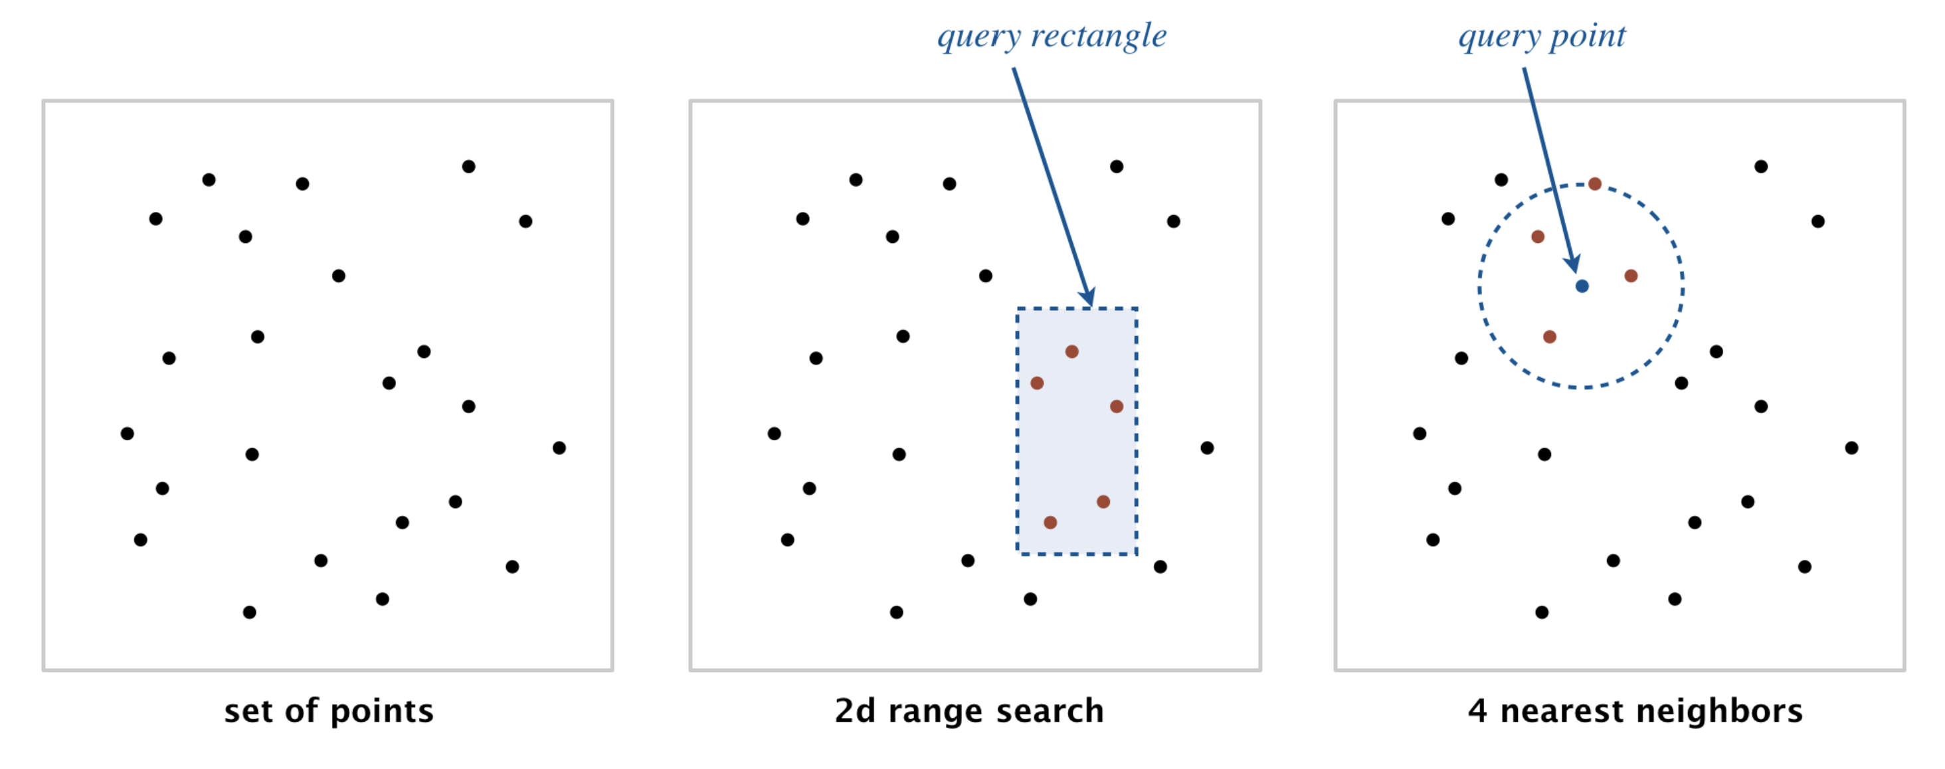
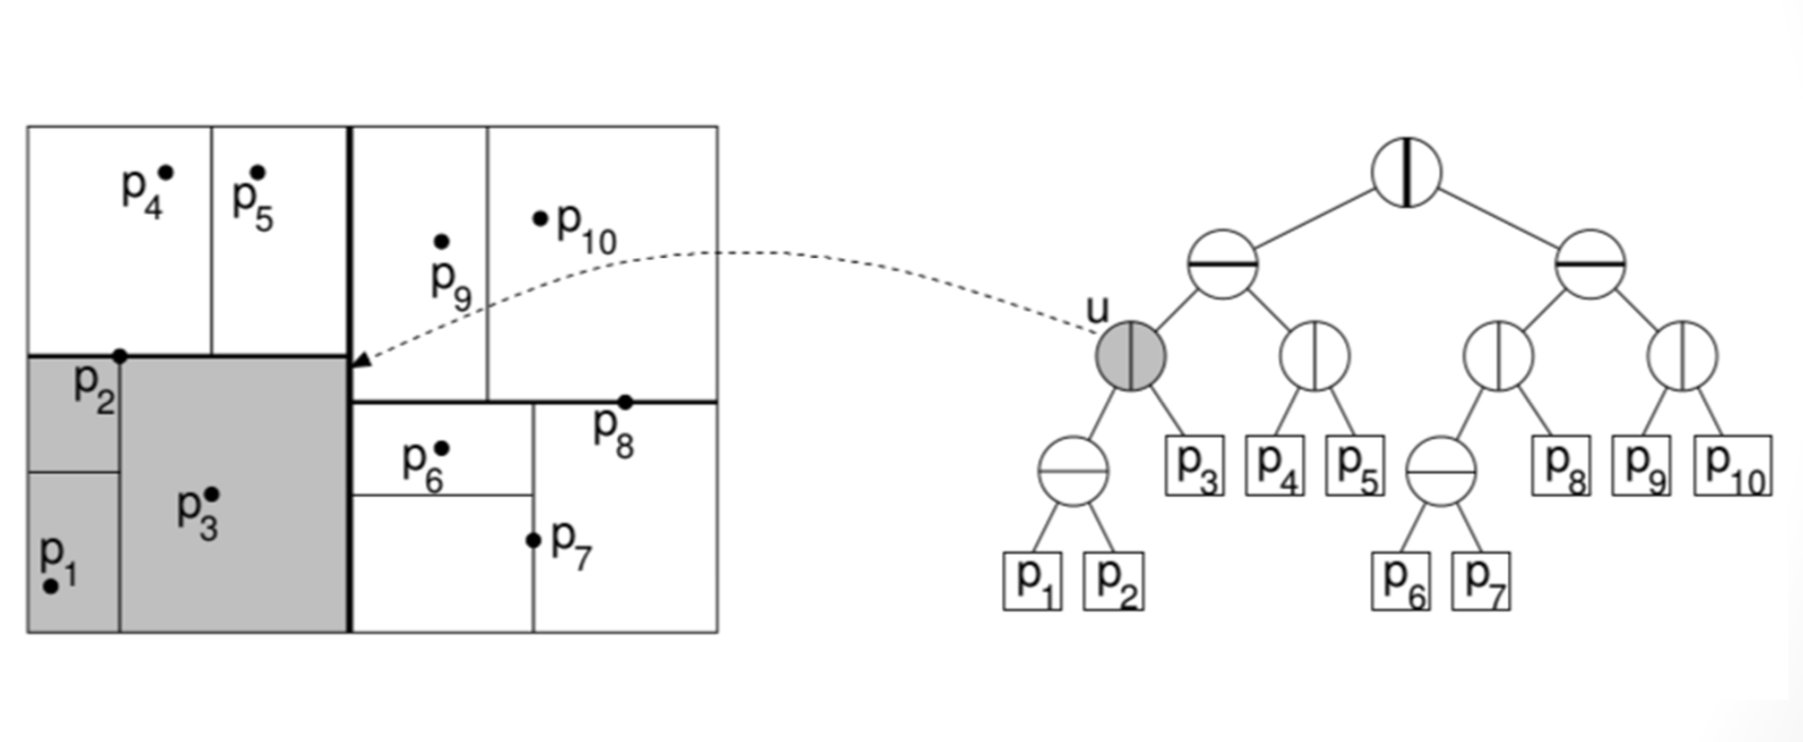
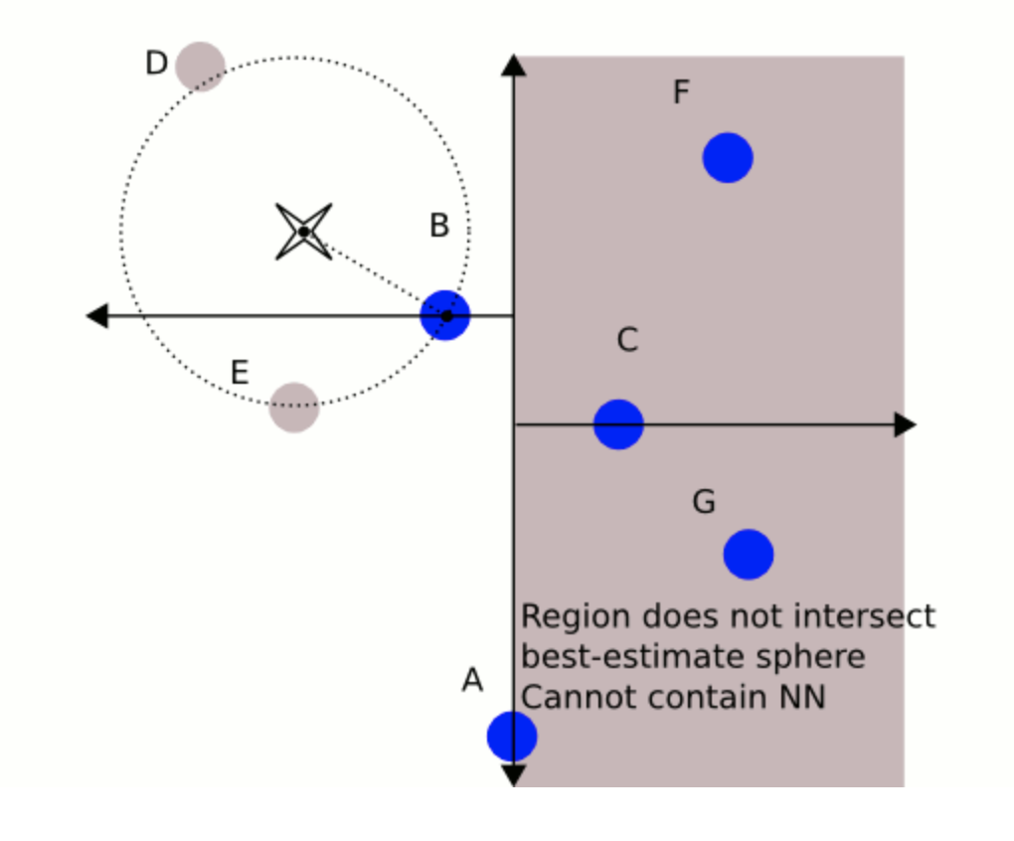
kD-Trees (here just 2D but more general) (con amore, but part of project 5 option)
This is the first of two formal slides on kD-Trees, today.
The rest will be free wheeling, or ”winging it”, with some interesting applications in sight.
Oct-tree (for 3D, e.g.)
Quad-tree (2D, e.g.)
Nearest neighbor search

